Slide 1

Class of 2026 Parent & Student Information

Slide 2
Senior Meetings
Counselors have met with all seniors individually to go over graduation plans.
Plans were given to students to bring home and get signed.
Plans show what classes are still needed to complete graduation requirements this school year.
Also included on the Senior Graduation Plan is information regarding the HOPE scholarship and students' current GPA.
  Note: To graduate with Honors, students’ final GPA must be an 89.5 or higher.

Slide 3
Graduation Requirements:
Please Note: Two units of World Language are not required for high school graduation, but if a student has intentions to go to a 4-year college (example: University of West Georgia), two units are required to be admitted.
Areas of Study: | Units Required:
English / Language Arts | 4
Mathematics | 4
Science | 4
Social Studies | 3
CTAE and/or Fine Arts and/or World Language | 3
Health and Personal Fitness (OR 3 credits of JROTC meets this requirement) | 1
Electives | 4
Total Units (Minimum) | 23
Each block is worth 1 credit and a student must earn a 70 or above to pass their class. If a student fails a course required for graduation, they will have to repeat the course to earn the credit.

Slide 4

Dual Enrollment
Dual Enrollment is a program that allows GA students enrolled in grades 10-12 to earn college credits while in high school, at no cost.
It may be possible for Seniors to still enroll for 2nd semester; however, deadlines are quickly approaching.
Speak with your counselor ASAP if interested.

Slide 5
Considerations for College
Do your research – GAFutures, college websites, college visits
Review admission requirements/freshman profile
Complete application
  Through school website
  Common App
Submit supporting documents
  Test scores -Note that some schools are test-optional, may depend on GPA
  Transcript
  Application fees (See if you qualify for a waiver)
  Recommendations - (if needed allow a minimum of ten days)
    Counselor Recommendations
    Teacher Recommendations
https://pchscounselor1297.wixsite.com/mysite/senior-brag-sheet
Most colleges have tours and/or open houses that you can attend to learn more about the school and see if you are interested in attending.
Check the college’s website.
Any college visit will be considered an excused absence if it occurs during the school day.
Some colleges will be visiting PCHS during school hours to talk to students. We will make announcements and have sign-up sheets as they are available

Slide 6


Slide 7
Letters of Recommendation
If applying to a college that requires a letter of recommendation, visit the Counseling webpage (can be accessed by visiting PCHS’s homepage and clicking on “Counseling”), and click on “Senior Brag Sheet.” Directions will be provided for students to create a Collegevine account and provide us with information about themselves
The more information you give us, the better! The more you tell us, the more we can brag on you in our letters!

Slide 8
Transcript Requests
Students can request transcripts to be sent to colleges they are applying to by filling out the transcript request form that can be found on the counseling website under “Transcript Request.”
Transcript Request Link
At the end of the year, students will need to notify counselors of where they want their FINAL transcript sent to. Colleges will make admissions decisions based on current transcripts but will also need a final one that includes all courses and the graduation date.
  Instructions on how to do this will be provided at the end of the year.

Slide 9
SAT & ACT
Sign up now if you haven’t tested or need to retake.
Make sure official scores (as well as official transcripts) are sent to all schools and NCAA or NAIA clearinghouse, when appropriate.​
If you are eligible for the Zell Miller level of the HOPE scholarship, be sure to have scores sent to Georgia Student Finance Commission.
Check deadlines for applications so scores are available to meet those deadlines.
Fee waivers - If you qualify for Free or Reduced Lunch, you are eligible for SAT and ACT fee waivers which allow you to take both tests for free. Please see Mrs. Trice or your counselor in the guidance office for a waiver. Be sure to fill out the free/reduced lunch application for the 25-26 school year if you have not already and you think you may be eligible. It can be found here.

Slide 10
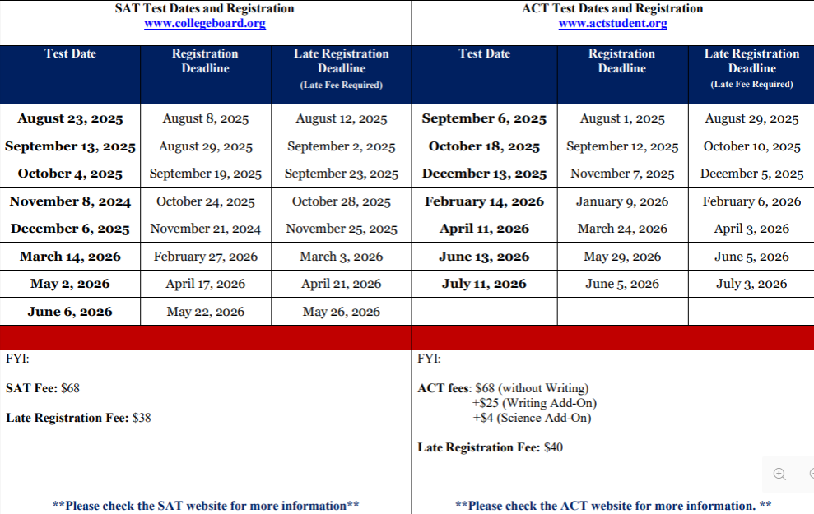

Slide 11
ASVAB
Aptitude exam required for entrance into the military that determines your eligibility for military jobs.
Will be given at PCHS on November 19th and March 25th. Registration information will be made available closer to date.
See JROTC instructors with any questions.
Be on the lookout-military recruiters often make lunchroom visits to speak with interested students.

Slide 12
Important Website - GAfutures.org
www.gafutures.org
Familiarize yourself with GAfutures. If you have not already created an account, do so. There is a lot of valuable information listed on this website.
This is the website that you will visit to check your HOPE GPA (remember this is different than the school GPA that is posted on your transcript), and GA Futures is the only place to check this. GAfutures also has information about scholarships and state aid programs, FAFSA and Financial Aid, career exploration, and many more valuable resources. The Dual Enrollment funding application is completed through GAfutures.
You can also research colleges, apply to some in-state colleges/universities, and request that your transcripts be sent to in-state colleges through GAfutures.

Slide 13
HOPE Scholarship
Georgia's HOPE Scholarship provides money to assist students with tuition at an eligible USG, TCSG, or private college/university.
Must be a state resident for 12 consecutive months prior to the first day of the term.
The HOPE scholarship is determined by the calculation of all academic core and world language courses that the student has taken and completed (grades 9-12).
Students must have a HOPE GPA of 3.0
Zell Miller- must have a HOPE GPA of 3.7 AND
  A minimum composite score of 25 on the ACT or a minimum score of 1200 on the SAT.
Students must have 4 “rigorous” academic courses to qualify for the HOPE Scholarship.
Georgia Student Finance Commission Rigorous Course Chart is located on GAfutures.
Courses taken during middle school do not count.
Remember to monitor your HOPE GPA via your My GAfutures account.
Apply by filling out the Free Application for Federal Student Aid (FAFSA) or the online Georgia Student Finance Application (GSFAPP).
Full requirements and details can be found at www.gafutures.org

Slide 14

HOPE GPA
If a student does not have these three key fields correct in our Student Information System as well as in their MyGAfutures Profile on GAfutures, there will be NO HOPE Scholarship:
Legal name that is on birth certificate
Social Security Number
Birth Date
All of the above items must match on:
Infinite Campus (Student Information System)
GAfutures
FAFSA
College Admissions Documents
SAT/ACT

Slide 15
Local Scholarships
Local scholarships are available for Seniors through the Paulding Education Foundation.
Pauldingeducationfoundation.com/scholarships
The application will open next semester.
We will post scholarships as they are sent to us on the “Scholarships” page of the counseling website.
Scholarship search engines can also be found here.

Slide 16
Apply to College Day
We will have an “Apply to College Day” in November. Date TBD
Students who need help filling out their college applications, have questions, or just want a dedicated time/space to work on applications can sign up.
Many colleges in GA waive their application fees during the month of November.
A sign-up link will be sent out to students closer to the date.

Slide 17
Athletics
In order to be eligible for sports, students must be on track with credits & earn at least 2.5 credits the previous semester.
If you are an athlete and plan to play sports in college, to be eligible for NCAA Division I or II college athletics, a student must register with the NCAA Eligibility center. It is the student/parent’s responsibility to be sure that all requirements are met. Please refer to the NCAA website for more information.
To be eligible to play college athletics at an NAIA-sanctioned school, a student must register with the NAIA Eligibility Center. It is the student/parent’s responsibility to be sure that all requirements are met. Please refer to www.playnaia.org for more information.

Slide 18
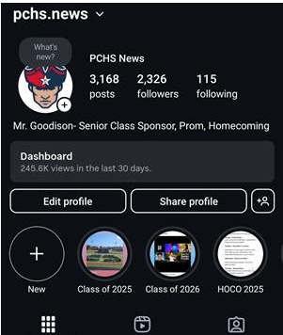
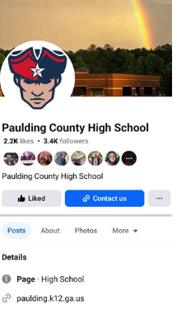
Stay in the Know
Important Senior information is posted on the PCHS homepage under “Student Resources.”
Check this page regularly. Information regarding senior dues, cap/gown, prom, yearbook, senior events, etc. can all be found here.
Senior dues are $85 now through the end of December.
  Prices increases to $100 in January.
Counseling website- scholarships, transcript requests, letters of rec
Social Media
  Follow PCHS on Facebook at Paulding County High School and on Instagram at pchs.news to keep up with important information as well including school events, student highlights, clubs & activities, sports, etc!

Slide 19
Congratulations Class of 2026!
Students can stop by the counseling office any time they have a question, need help with something, or need to talk.
QR codes are in every classroom for students to request an appointment to see us.
Please reach out if there is anything that we can help you with!
Graduation is on May 20th at 8PM.

Slide 20
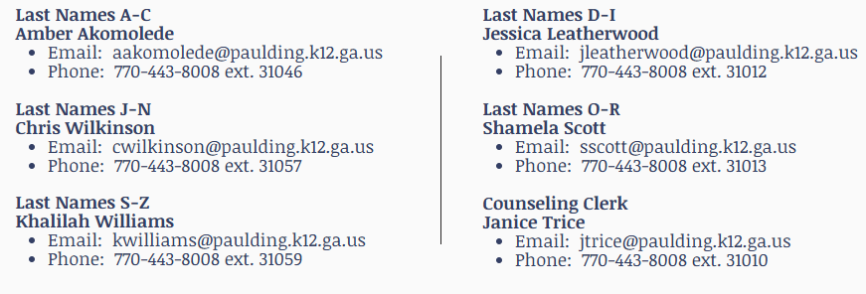
Questions?
Contact us

