Slide 1

9th-11th Parent & Student Information

Slide 2
Important Facts to Remember:
For promotion to the next grade level:
At least 5 credits must be earned for a student to be considered a sophomore.
At least 11 credits must be earned for a student to be considered a junior.
At least 17 credits must be earned for a student to be considered a senior.
At least 23 credits must be earned for a student to GRADUATE!!!
A transcript is a record of all the classes taken in high school and includes grades and credits for ALL classes, whether pass or fail.
All grades count toward the overall GPA (Grade Point Average) and earning credits for graduation.
To graduate with honors, students must have a final GPA of an 89.5 or higher

Slide 3
Graduation Requirements:
Please Note: Two units of World Language are not required for high school graduation, but if a student has intentions to go to a 4-year college (example: University of West Georgia), two units are required to be admitted.
Areas of Study: | Units Required:
English / Language Arts | 4
Mathematics | 4
Science | 4
Social Studies | 3
CTAE and/or Fine Arts and/or World Language | 3
Health and Personal Fitness (OR 3 credits of JROTC meets this requirement) | 1
Electives | 4
Total Units (Minimum) | 23
Each block is worth 1 credit and a student must earn a 70 or above to pass their class. If a student fails a course required for graduation, they will have to repeat the course to earn the credit.

Slide 4
Graduation Requirements
English
Required: 4 total units
1 Full credit of Lit & Comp I
1 Full credit of Lit & Comp II
2 Additional Core Credits of English
Social Studies
Required: 3 total units
1 Full credit of World History
1 Full credit of US History
½ credit of American Government
½ credit of Personal Finance & Economics
Math
Required: 4 total units
1 Full credit of Algebra Concepts & Conn
1 Full credit of Geometry Concepts & Conn
1 Full credit of Adv. Algebra Concepts & Conn
1 Additional Core Math Credit
CTAE/Fine Arts/ World Language
Required: 3 total units
Do not have to all be in the same category. Example: student could have 1 CTAE credit, 1 World Language credit, and 1 Fine Arts
Science
Required: 4 total units
1 Full credit of Biology
1 Full credit of Physical Sci OR Physics
1 Full Credit of Chemistry OR Environmental Sci OR Earth Systems
1 Additional Core Science Credit
Additional Electives
Required: 4 total units
(Examples include: weight training, team sports, psychology, mythology, etc.)
Health/Personal Fitness
Required: 1 total unit OR
3 credits of JROTC

Slide 5
Being a Pathway Completer
Plan of Study:
All students are strongly encouraged to select a Plan of Study/Pathway and complete a sequence of 3 courses in one of the following areas:
  CTAE
  Advanced Academics
  Fine Arts
  World Language

Slide 6
Embedded Credits
Some high schools offer courses that have “Embedded Credits”. This is where a student will take a course and if they pass the course, then the student will be awarded two credits for taking the one course.
Two Examples:
  Essentials of Healthcare has an embedded credit of Human Anatomy and Physiology.
  Dramatic Writing has an embedded credit of Advanced Composition.
Both courses can count for HOPE
There are many options for Embedded Credits through CTAE courses.

Slide 7
Advanced Course Offerings
Honors
Introduction to Advanced Classes
+5 Points on Transcript
Advanced Placement
Preferred by Larger Schools for College Enrollment (GT/UGA)
+10 Points on Transcript
Dual Enrollment
College & HS Credit Simultaneously
30 Free Credit Hours starting Junior Year
10+ Points

Slide 8

What if I wanted to take a course Online during high school?
During the months of April – Mid-July, there will be a PCSD online registration opportunity for high school courses.
Senate Bill 289 allows Georgia districts to provide students in grades 3 through 12 the option of taking an online course should you choose that option.

Slide 9




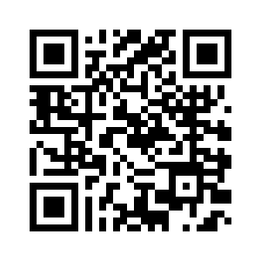




NEW
DISCOVER
OPPORTUNITIES
@
Paulding Virtual Academy
PVA offers a 100% virtual online high school to any PCSD high school student interested. We offer all courses required by the State of Georgia for graduation as well as many electives not offered in traditional face-to-face schools. For a complete list of courses offered visit our website at https://www.paulding.k12.ga.us/Domain/41 or scan the QR code.
At New Hope Education Center, PVA also partners with the Paulding College and Career Academy and Chattahoochee Technical College for opportunities to:
  complete various Career Pathways
  earn both high school and college credits by taking Dual Enrollment courses
  earn certificates for jobs in high-demand industries.
For more information & questions, please email:
pauldingvirtual@paulding.k12.ga.us

Slide 10


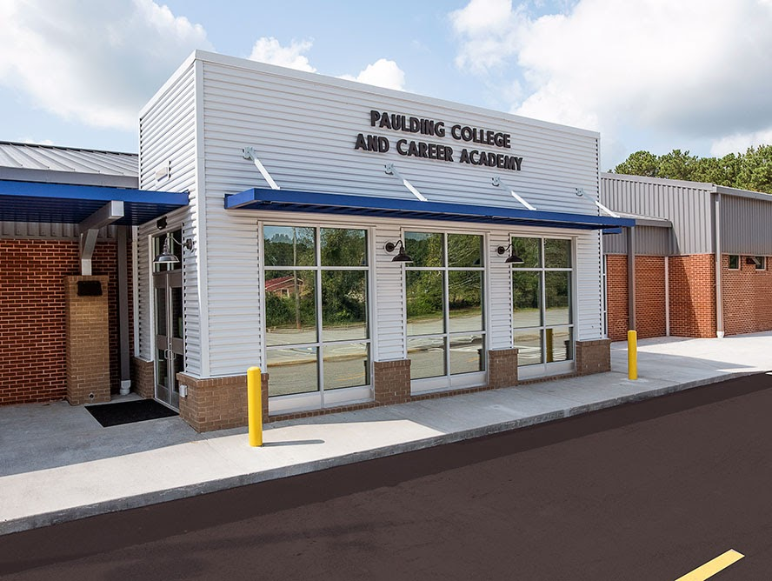
Paulding College & Career Academy
When do I come to class?
Students attend either an AM or PM session on our campus.
How do I get to PCCA?
Bus transportation is provided to PCCA from the home high schools each day for both sessions. Students are also allowed to drive to PCCA (with the purchase of a $10 per year parking pass)
How many classes do I take during my PCCA session?
Students will take two classes, but there are many combinations of classes that students can take. These can include: PCCA Pathway courses, PCCA Dual Enrollment courses, Work-Based Learning, online courses, and minimum day (Seniors only).

Slide 11


PCCA Pathways
Mechatronics -
(Engineering/Robotics/Aviation)
Cybersecurity
Energy - Lineman
Healthcare
  Certified Nursing Assistant
  Certified Medical Assistant
  Patient Care Tech

Slide 12

Sports Eligibility
All first-time 9th Grade Students are Eligible in the Fall.
Eligibility Depends On:
  Active Physical Exam (Good for 12 Months)
  Passing 2.5 Credits in the Previous Semester.
  Being “On-Track” for Graduation
    This means having at least:
      5 Credits as a 10th Grader
      11 Credits as a 11th Grader
      17 Credits as a 12th Grader
  Discipline: ISS/OSS= No Practice/Games
  Eligibility is determined by the GHSA and the above are just the most common requirements. Full requirements can be found at www.ghsa.net .

Slide 13
Athletics
If you are an athlete and plan to play sports in college, to be eligible for NCAA Division I or II college athletics, a student must register with the NCAA Eligibility center. It is the student/parent’s responsibility to be sure that all requirements are met. Please refer to the NCAA website for more information.
To be eligible to play college athletics at an NAIA-sanctioned school, a student must register with the NAIA Eligibility Center. It is the student/parent’s responsibility to be sure that all requirements are met. Please refer to www.playnaia.org for more information.

Slide 14


YouScience
An aptitude assessment that students take in the 10th grade. Uses a series of 9 science-based brain games and an interest survey to uncover a students’ aptitudes and interests.
Each students’ YouScience profile:
Is a scientific measurement of natural aptitudes and interests as a basis for career recommendations
Is a comprehensive profile including aptitude, interest, and personality assessments, extensive personal feedback, and career and educational recommendations
Answers these questions:
What do you do well?
What do you enjoy?
How to prepare?
What are the market needs in terms of careers?

Slide 15
Academic Testing in High School
End of Course Tests
Literature & Composition II
Biology
U.S. History
Algebra Concepts & Connections
PSAT
Preliminary Scholastic Aptitude Test
Provides a standardized view of a student’s scholastic skills and helps students compare themselves with other college-bound students nationwide.
Was taken Oct 23rd.
SAT / ACT
Standardized tests that colleges use to evaluate applicants

Slide 16
SAT & ACT
If you are planning to attend a four-year college/university, you may need to take the ACT or SAT for acceptance. Please research your schools carefully.
Make sure official scores (as well as official transcripts) are sent to all schools and NCAA or NAIA clearinghouse, when appropriate.​
If you are eligible for the Zell Miller level of the HOPE scholarship, be sure to have scores sent to Georgia Student Finance Commission.
Check deadlines for applications so scores are available to meet those deadlines.
Fee waivers - If you qualify for Free or Reduced Lunch, you are eligible for SAT and ACT fee waivers which allow you to take both tests for free. Please see Mrs. Trice or your counselor in the guidance office for a waiver. Be sure to fill out the free/reduced lunch application for the 25-26 school year if you have not already and you think you may be eligible. It can be found here.

Slide 17
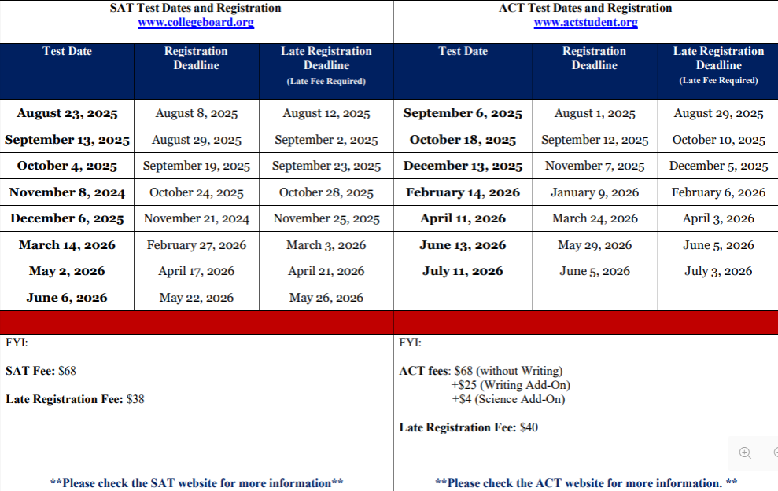

Slide 18
ASVAB
Aptitude exam required for entrance into the military that determines your eligibility for military jobs.
Will be given at PCHS on November 19th and March 25th. Registration information will be made available closer to date.
See JROTC instructors with any questions.
Be on the lookout-military recruiters often make lunchroom visits to speak with interested students.

Slide 19

Dual Enrollment?
Dual Enrollment (DE) is a program where Georgia students enrolled in grades 10-12 can earn high school course credits while taking college courses.
DE is available for all 11th and 12th grade students and some 10th grade students meeting certain criteria.
  10th Grade students can take CTAE classes at Technical Schools.
  10th Grade students meeting Zell Miller Requirements (1200 SAT or 25 ACT/3.7 GPA) can take core classes.
Student can take up to 30 hours of college courses for Free!
Speak to your counselor if interested and for more information

Slide 20
Things to consider with being a Dual Enrollment Student…
Maturity level of the student
Post-secondary plans of the student
Individual career goals and IGP (Individual Graduation Plan)
Necessary tests for admission to the postsecondary institution(s) of choice
Application and acceptance by the post-secondary institution

Slide 21
Important Website - GAfutures.org
www.gafutures.org
Familiarize yourself with GAfutures. If you have not already created an account, do so. There is a lot of valuable information listed on this website.
This is the website that you will visit to check your HOPE GPA (remember this is different than the school GPA that is posted on your transcript), and GA Futures is the only place to check this. GAfutures also has information about scholarships and state aid programs, FAFSA and Financial Aid, career exploration, and many more valuable resources. The Dual Enrollment funding application is completed through GAfutures.
You can also apply to some in-state colleges/universities and request that your transcripts be sent to in-state colleges through GAfutures.

Slide 22
HOPE Scholarship
Georgia's HOPE Scholarship provides money to assist students with tuition at an eligible USG, TCSG, or private college/university.
Must be a state resident for 12 consecutive months prior to the first day of the term.
The HOPE scholarship is determined by the calculation of all academic core and world language courses that the student has taken and completed (grades 9-12).
Students must have a HOPE GPA of 3.0
Zell Miller- must have a HOPE GPA of 3.7 AND
  A minimum composite score of 25 on the ACT or a minimum score of 1200 on the SAT.
Students must have 4 “rigorous” academic courses to qualify for the HOPE Scholarship.
Georgia Student Finance Commission Rigorous Course Chart is located on GAfutures.
Courses taken during middle school do not count.
Remember to monitor your HOPE GPA via your My GAfutures account.
Apply by filling out the Free Application for Federal Student Aid (FAFSA) or the online Georgia Student Finance Application (GSFAPP).
Full requirements and details can be found at www.gafutures.org

Slide 23

HOPE GPA
If a student does not have these three key fields correct in our Student Information System as well as in their MyGAfutures Profile on GAfutures, there will be NO HOPE Scholarship:
Legal name that is on birth certificate
Social Security Number
Birth Date
All of the above items must match on:
Infinite Campus (Student Information System)
GAfutures
FAFSA
College Admissions Documents
SAT/ACT

Slide 24
HOPE GPA
Classes Included in HOPE GPA
Classes NOT in HOPE GPA
English
Science
Math
Social Studies
World Language
CTAE
P.E.
Non-Core Electives
Fine Arts
Any High School Course Taken in Middle School.

Slide 25
Example of Traditional GPA vs. HOPE GPA
Traditional GPA
HOPE GPA
Advanced Algebra – B (3 pts.)
U.S. History- C (2 pts)
Intro to Team Sports- A (4 pts.)
Intro to Digital Tech- B (3 pts)
(3+2+4+3)/4= 3.0 GPA
Advanced Algebra – B (3 pts.)
U.S. History- C (2 pts)
Intro to Team Sports- A (0 pts)
Intro to Digital Tech- B (0 pts)
(3+2)/2= 2.5 GPA

Slide 26

Work-Based Learning
A student may be eligible to participate in one of the Work-Based Learning Programs.
  Opportunities include:
    Youth Apprenticeship
    Cooperative Education
    Internship
    Employability Skills Development
Benefits:
  Start your career while you are in high school
  Develop employability and technical skills to be successful
  Network and make connections in your chosen industry
  11th and 12th graders only
Interested students should contact the school counselor or WBL Coordinator for additional information.
Slide 37

Slide 27
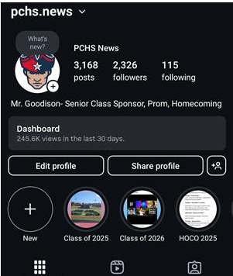
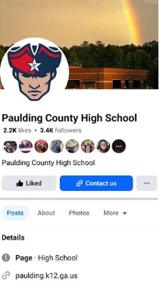


Stay in the Know
PCHS website
Counseling website- (access from PCHS homepage)
Social Media
  Follow PCHS on Facebook at Paulding County High School and on Instagram at pchs.news to keep up with important information as well including school events, student highlights, clubs & activities, sports, etc!

Slide 28
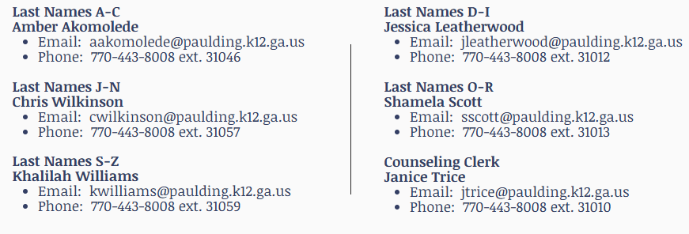
Questions?

